Slide 1
Machine Learning in Disk Algorithms

Slide 2
agenda
Introduction 3
CPP Code 4
Matplotlib Visualization 5
Algorithms 6
Machine Learning Approach 7
Website Integration 8
GitHub & LinkedIn 9

Slide 3
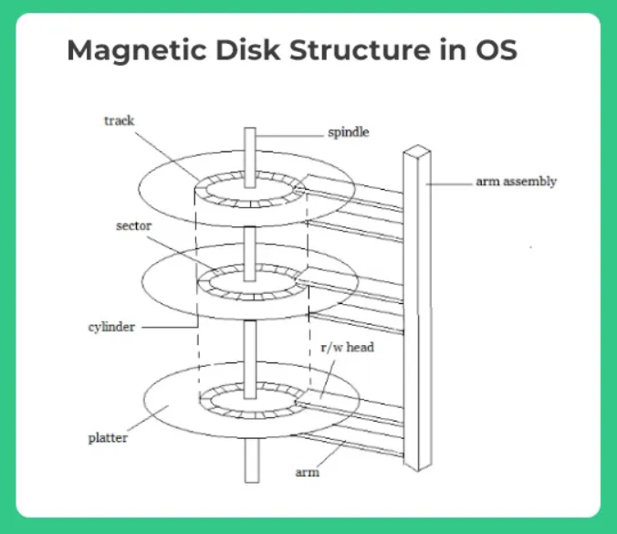
Working of Disk Architecture
Disk architecture refers to the structural design and organization of components within a hard disk drive (HDD).
Platters: The hard disk contains multiple circular platters made of glass or aluminum.
Tracks: Each platter surface is divided into concentric circles called tracks.
Sectors: Tracks are further divided into smaller segments known as sectors.
Cylinders: A cylinder is a set of tracks located at the same position on all platters.
Spindle: The spindle is a motor that rotates the platters at a consistent speed.
Read/Write Head: A read/write head floats above each platter surface.
Actuator Arm: The actuator arm holds the read/write head and moves it across the platter to access different tracks.

Slide 4
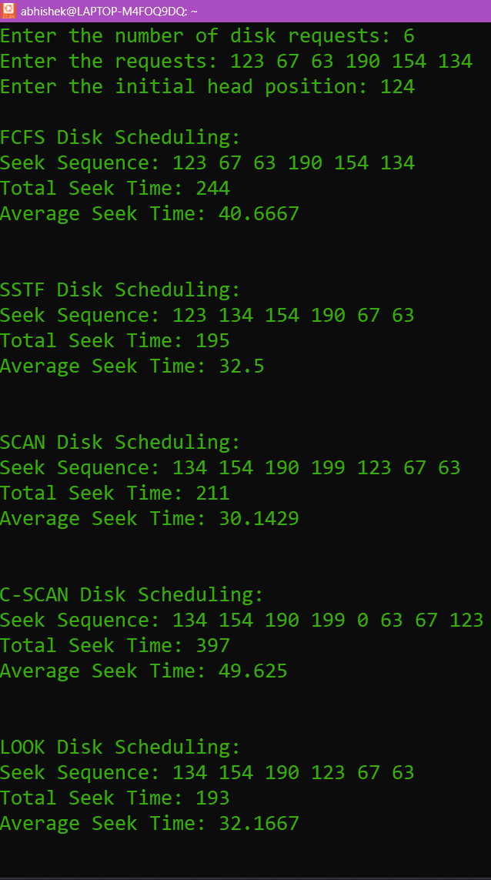
CPP Code
Objective:
Implement Disk Scheduling Algorithms:
Simulate various disk scheduling techniques such as FCFS, SSTF, SCAN, C-SCAN, LOOK, and C-LOOK.
Calculate Performance Metrics:
Determine the total head movement, which is crucial for analyzing algorithm efficiency.
Provide Algorithm-wise Comparison:
Help in comparing the performance of different scheduling algorithms on the same dataset.
Working Process:
Input Selection: Accepts disk requests which is an array that contains location of the head where the current head has to move.
Algorithm Selection: Selects best algorithm based on minimum seek time.
Head movement calculation: Based on the algorithm head movement is being calculated.

Slide 5
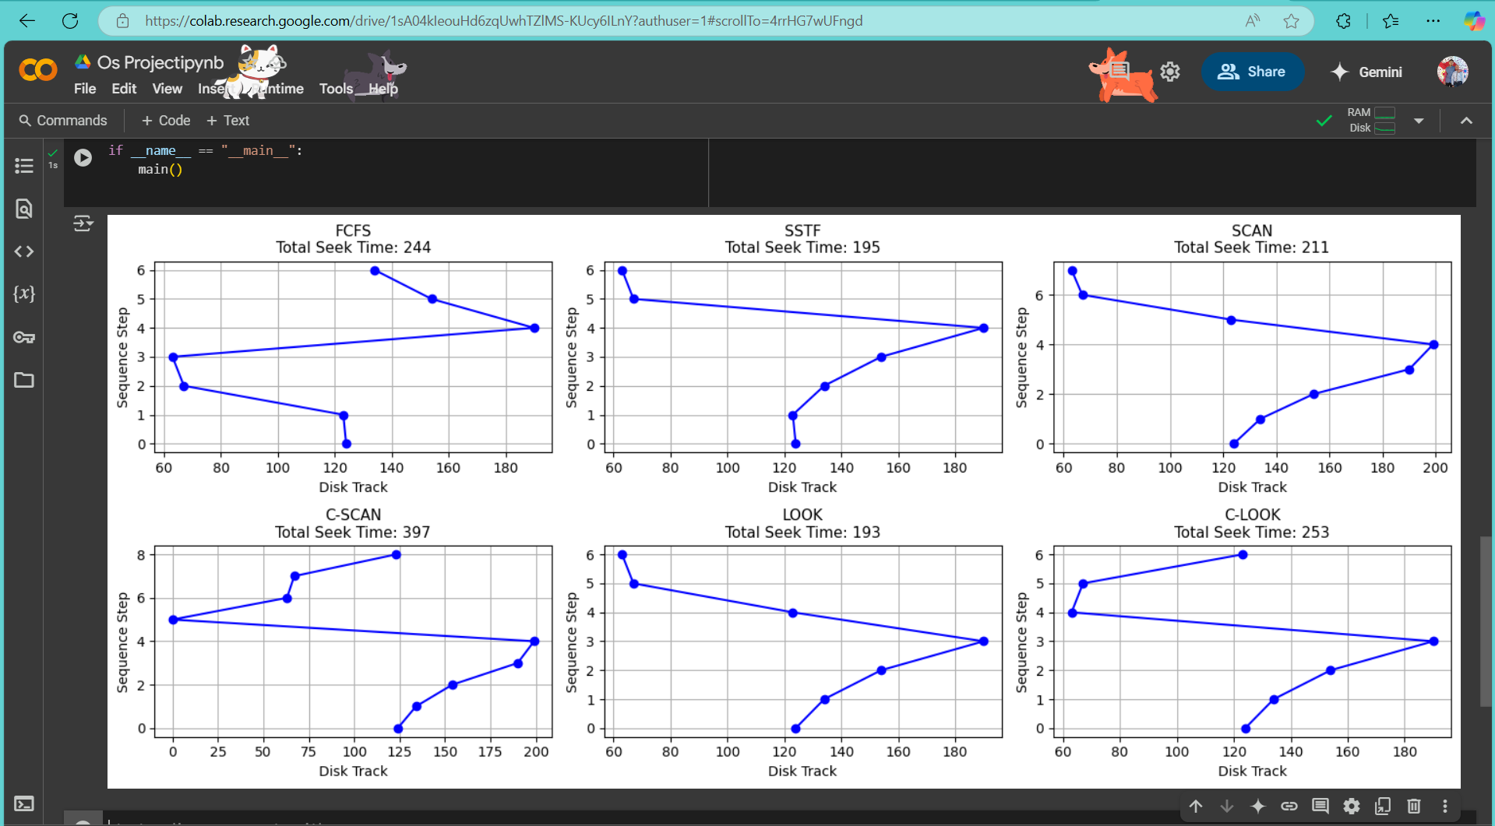
Python Code for Visualisation
Objective
To visually demonstrate disk head movement using Matplotlib for easier interpretation and analysis.
To help analyse the performance differences between algorithms through graphical representation.
To enhance understanding of scheduling logic through side-by-side subplots and algorithm simulation.
Working
Displays 6 subplots for 6 algorithms.
Shows exact path taken by disk head.
Provides total seek time for performance analysis.

Slide 6
Explanation of Algorithms
FCFS (First Come First Serve): Services disk requests in the order they arrive without reordering, resulting in high average seek time if requests are far apart.
SSTF (Shortest Seek Time First): Selects the request closest to the current head position, reducing total seek time but possibly starving requests located far away.
SCAN (Elevator Algorithm): Moves the disk head in one direction, servicing all requests until the end is reached, then reverses direction — like an elevator, providing fairness and reduced starvation.
C-SCAN (Circular SCAN): Moves in one direction only, and after reaching the end, jumps to the start without servicing requests during the return — ensures uniform wait times and prevents head oscillation.
LOOK: A smarter SCAN that reverses the head direction only after the last request in that direction, minimizing unnecessary movement across the disk.
C-LOOK: A circular version of LOOK that jumps from the last request to the first, servicing requests in one direction only improves efficiency and consistency in access times.

Slide 7
ML based approach
What is ML and why do we need that in this project?
Based on what is discussed earlier we can clearly see that we follow a mathematical way to find the minimum seek time. But with ML comes the trick of pattern matching. So what ML basically do is that it saves the answers of best performing algorithms based on disk request and head position and based on that it predicts the future best algorithm based on disk requests and head position.
How we have implemented ML in our project?
So we have opted for a simple and yet effective way of ML approach. We have integrated ML such a way that it learns continuously on the data that is being given to it whenever a new search is made. Suppose a user inserts disk request and head position so it is used a training set. Then after the model quickly predicts the best outcome based on the historical data.
It auto learns the data that is being given to it Realtime.
We have used TensorFlow for browser based machine learning and prediction.

Slide 8
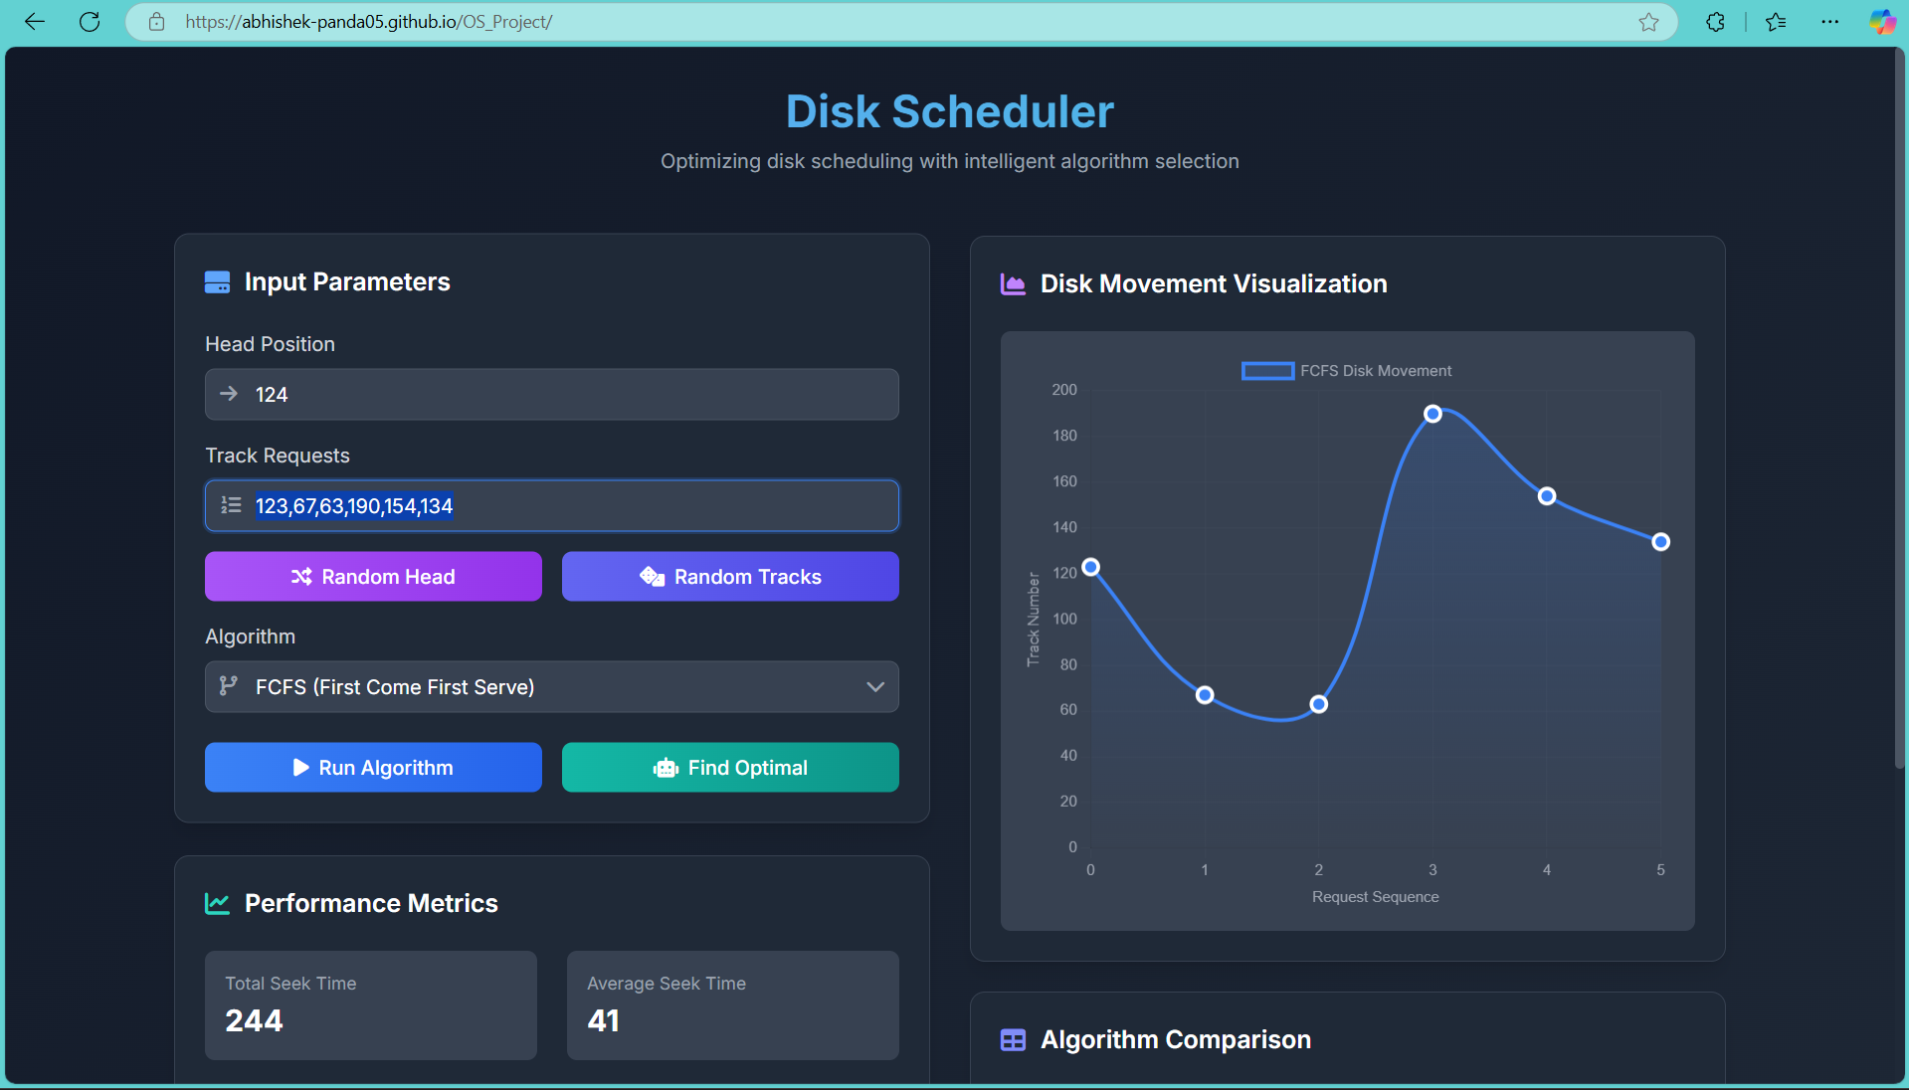
Combined Website that comprises of all the things discussed earlier
Click on this link to open the website: https://abhishek-panda05.github.io/OS_Project/

Slide 9


Scan this code for LinkedIn and GitHub Repo
GitHub Repo
LinkedIn Post

Slide 10
thank you

